Slide 1

Automobile Employee Management System
Theme- SDG Goals <SDG 8: Decent Work and Economic Growth
Category- Software
Group No - 12
Group Members- Rajeev Sangale, Arnav Sawant, Parth Shinde
Pushkraj Shrike.
Guide- Prof. Shraddha Shinde
SDG 9: Industry, Innovation, and Infrastructure
SDG 10 – Reduced Inequalities>

Slide 2
Outline
Introduction
Literature Survey
Limitations of existing systems
Problem statement and Objectives
Proposed Methodology
Experimental Setup
Implementation
Results & Analysis
Conclusion and Future work
References

Slide 3
Introduction
Background of the Topic
Automobile industry has a hierarchical workforce: Admins, Branch Managers, Salespersons
Traditional systems rely on manual records, spreadsheets, and paperwork
Data is often scattered across disconnected systems
Leads to inefficiencies in tracking sales and employee performance
Growing need of role based centralized and secure digital system
Importance of the Problem
Efficient employee & sales management drives revenue and growth
Lack of real-time tracking reduces transparency in performance
Incentives need accurate and timely sales data
Role-based system ensures security, accountability, and control
Data visualization helps analyze trends and performance

Slide 4
Introduction
Current Challenges
Manual tracking of sales and employee performance leads to errors and data redundancy.
Difficulty in comparing branch-to-branch performance due to scattered data sources.
Lack of performance trend analysis; reports are often static rather than analytical.
Inefficient user management and access control mechanisms.
Time-consuming report generation and dependency on paperwork or spreadsheets.

Slide 5
Introduction
Motivation
Manual record management reduces productivity → SDG 8
Lack of centralized digital systems → SDG 9
Time-consuming processes affect service quality → SDG 8
Poor data security and lack of backups → SDG 9
Limited access to digital tools & rising need for tech integration → SDG 10 & 9
Objectives
Automate manual processes to improve productivity → SDG 8
Enhance efficiency and reduce human errors → SDG 8
Develop a centralized digital system for data management → SDG 9
Strengthen data security with authentication & access control → SDG 9
Enable scalable, affordable tech access for workshops → SDG 9 & 10

Slide 6
Literature Survey
Sr. No. | Author & Year | Title of the Paper | Techniques / Method Used | Key Results
1 | Anu & Suresh Kumar (2025) | HR Analytics in Automobile Industry | Data-driven HR analytics | Improves employee productivity and decisionmaking
2 | ScienceDirect Study (2024) | Performance in Automotive Dealerships | Regression analysis | Enhances service advisor performance
3 | Springer Study (2022) | Predictive Analytics in Sales | Predictive modeling | Improves employee decision-making and sales outcomes
4 | Indupriya & Kalaiselvi (2019) | Performance Appraisal in Automobile Companies | Traditional appraisal methods | Moderate effectiveness in evaluation
5 | MDPI Study (2019) | Salesperson Performance Evaluation | KPI-based analytics | Identifies key performance indicators
6 | Sharma & Sharma (2017) | HR Analytics Framework for Performance | Conceptual HR analytics model | Reduces bias and improves performance evaluation

Slide 7
Limitations of Existing Systems
Lack of advanced role-based performance analytics (Admin, Manager, Salesperson level)
No branch-to-branch comparison dashboards for performance evaluation
Lack of integration between HR and sales performance systems
Manual, time-consuming, and biased appraisal methods
Mostly theoretical models with limited real-world implementation
Advanced systems need high data and resources (not SME-friendly)
Poor UI and lack of user-friendly visualization tools
Focus on specific roles, not complete employee performance analysis

Slide 8
Problem statement and Objectives
Automobile organizations rely on manual or fragmented systems to manage employees and sales operations.
Lack of a centralized platform leads to scattered data and inefficient monitoring.
Manual tracking of sales and employee performance increases errors and data redundancy.
Absence of real-time visibility delays decision-making and performance evaluation.
Static reports do not provide performance trends or analytical insights.
Limited branch-to-branch comparison restricts strategic planning and growth.
Need for a secure, role-based digital system to streamline employee, sales, and branch management operations.

Slide 9
TECHNICAL APPROACH
Frontend Technology: HTML, CSS, and JavaScript are used to design and develop the user interface, ensuring responsive layout and interactive user experience with Chart.js for performance visualization
Backend Technology: Python and Django are used to implement business logic, request handling, and system functionalities.
Database Technology: SQLite3 is used as the relational database for structured data storage and management.
Django Framework: Provides a high-level web framework that supports rapid development, security, and scalability.
Django ORM: Enables efficient database interaction using object-oriented models instead of raw SQL queries.
Django Authentication System: Ensures secure user login, role-based access control, and password management.
Django Development Server: Used for testing and running the application during the development phase.
Python Virtual Environment: Maintains project-specific dependencies and ensures isolated and organized development setup.

Slide 10
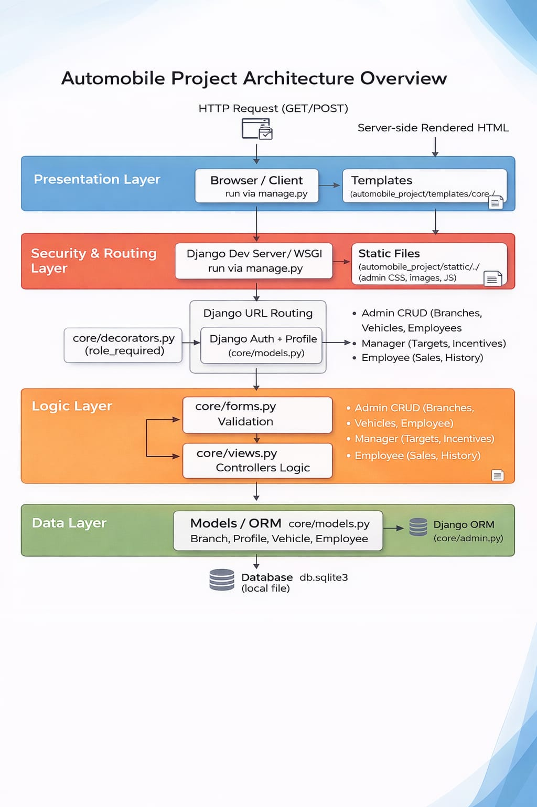
Proposed Methodology

Slide 11
Proposed Methodology
The proposed Automobile Employee Management System is a centralized web-based application designed to manage employee data and analyze performance at both employee and branch levels. It integrates sales tracking, employee monitoring, and performance analytics into a single platform.
The system provides role-based access for Admin, Manager, and Employee, ensuring secure operations. It focuses on real-time data processing, interactive dashboards, and performance insights to improve decision-making and productivity.
The Presentation Layer (Frontend): It is the topmost layer that interacts directly with users. It is developed using HTML, Bootstrap, and JavaScript, and is responsible for displaying user interfaces such as dashboards, forms, reports, and charts. This layer allows Admin, Manager, and Employee users to interact with the system easily.

Slide 12
Proposed Methodology
The Application Layer (Backend): It acts as the core processing unit of the system. It is implemented using the Django framework and handles business logic, request processing, and role-based access control. This layer processes user inputs, performs validations, calculates employee and branch performance, and communicates with the database.
The Data Layer (Database): It is the bottom layer responsible for storing and managing all system data. It uses an SQLite database to maintain records such as employees, vehicles, sales transactions, targets, and incentives. This layer ensures data integrity and supports efficient data retrieval.

Slide 13
Experimental Setup
Input / Dataset
The system uses employee data (profiles, roles, branch details), sales records, vehicle information, and transaction history stored in a centralized database (SQLite). Data is processed through Django models and ORM for structured management.
Software Setup
Operating System: Windows 10/11 (or Linux/MacOS)
Programming Language: Python 3.x
Framework: Django 4.
Database: SQLite3
Frontend Technologies: HTML5, CSS3, Bootstrap 5, JavaScript
Libraries/Tools: Django Humanize (for formatting data), Chart.js (for data visualization and graphs), IDE/Code Editor: Visual Studio Code, Web Browser: Google Chrome / Microsoft Edge, Version Control (Optional): Git6.2.2
Hardware Requirements
Processor: Intel Core i3 or higher
RAM: Minimum 4 GB (8 GB recommended)
Storage: At least 500 MB free disk space
System Type: 64-bit system
Network: Internet connection (for updates and dependencies)

Slide 14
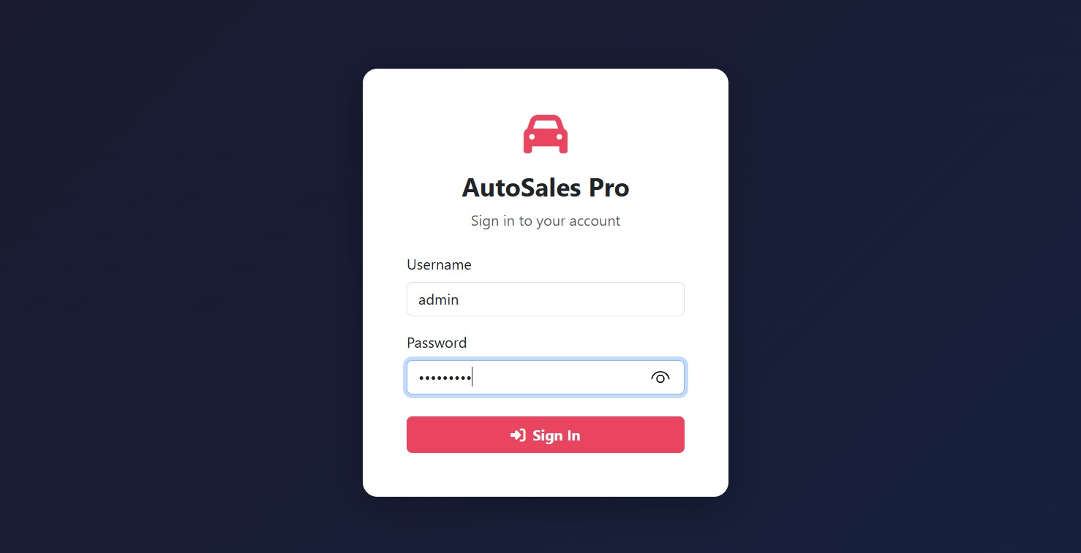
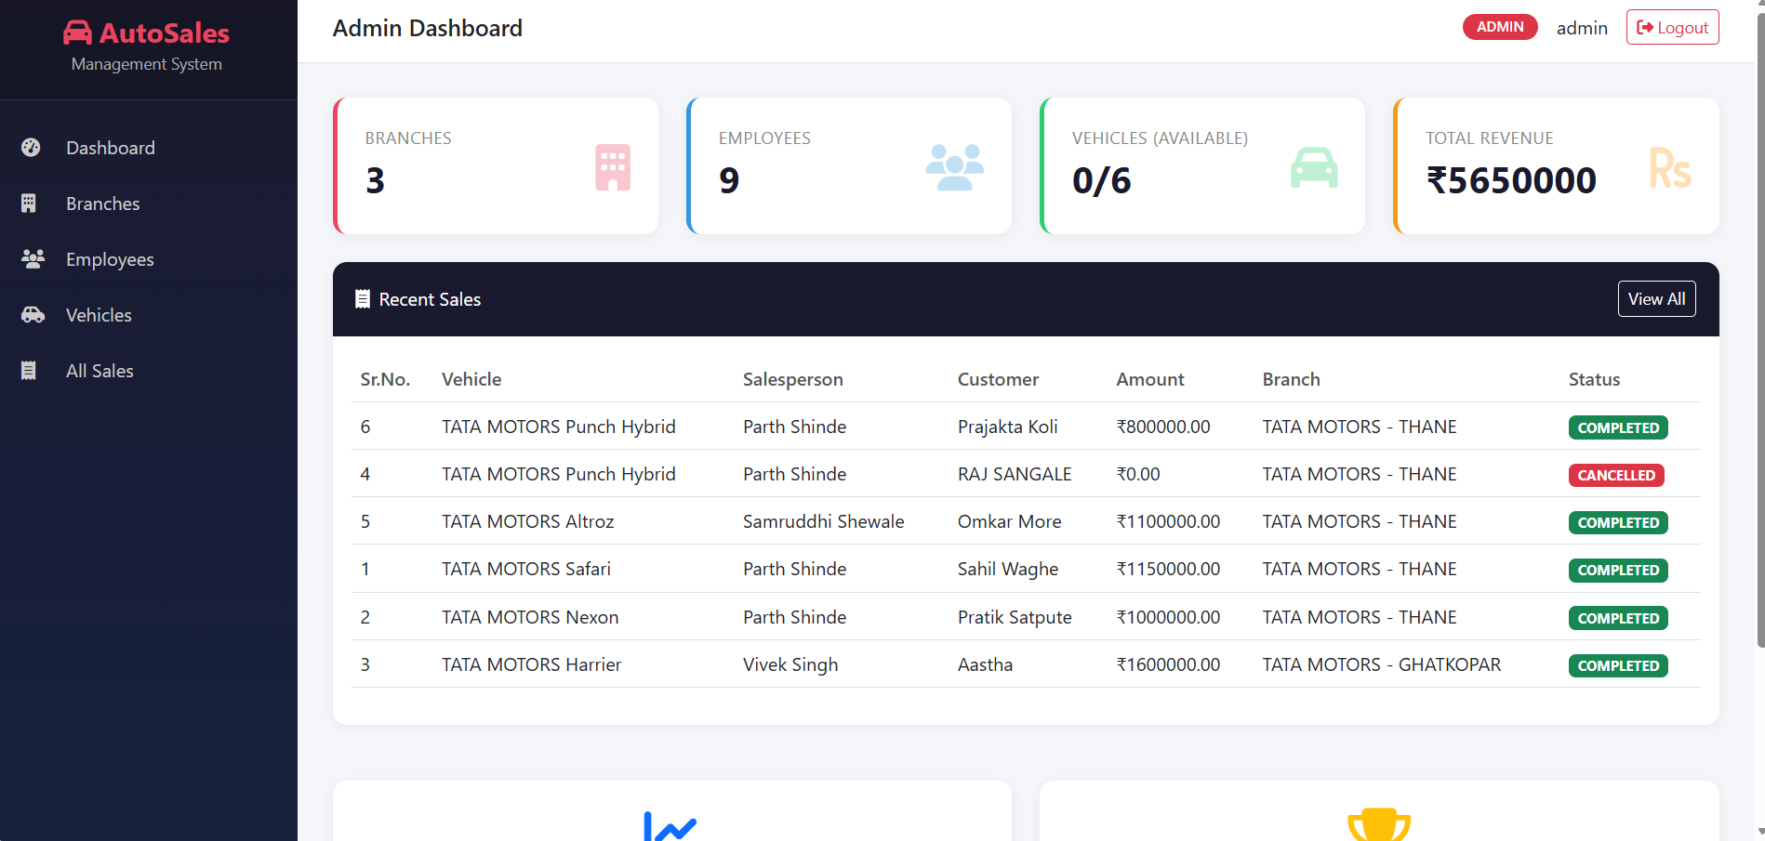
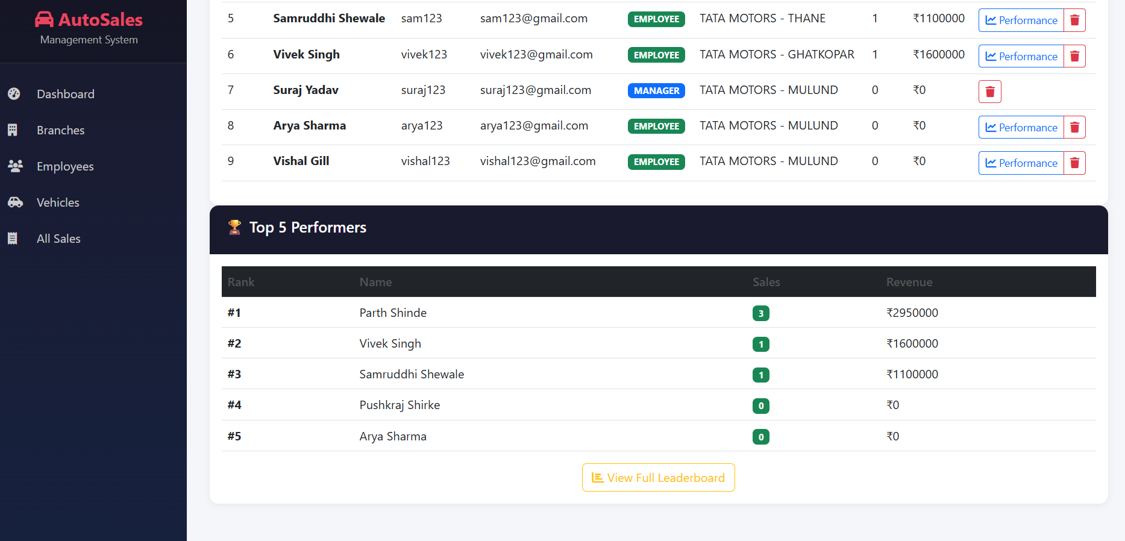
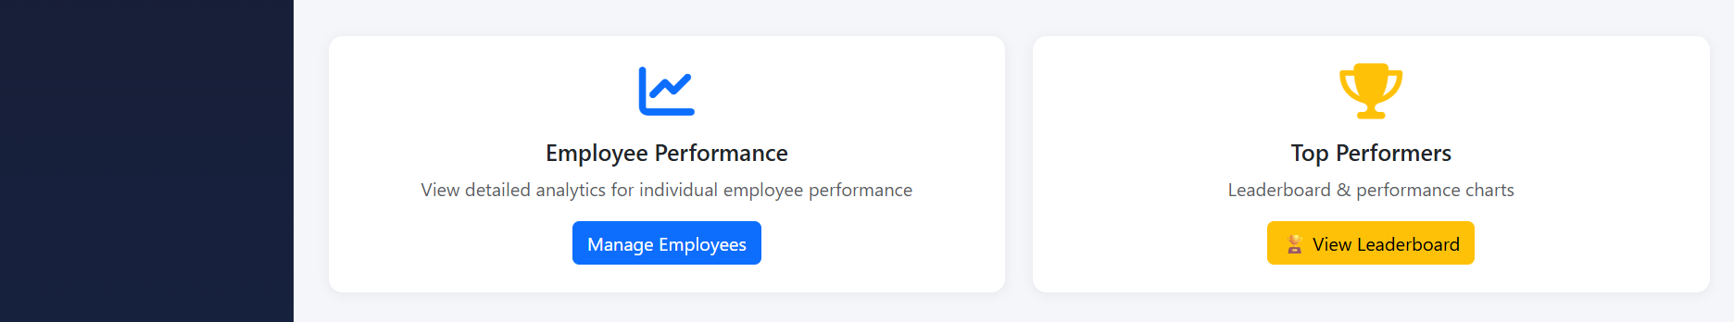
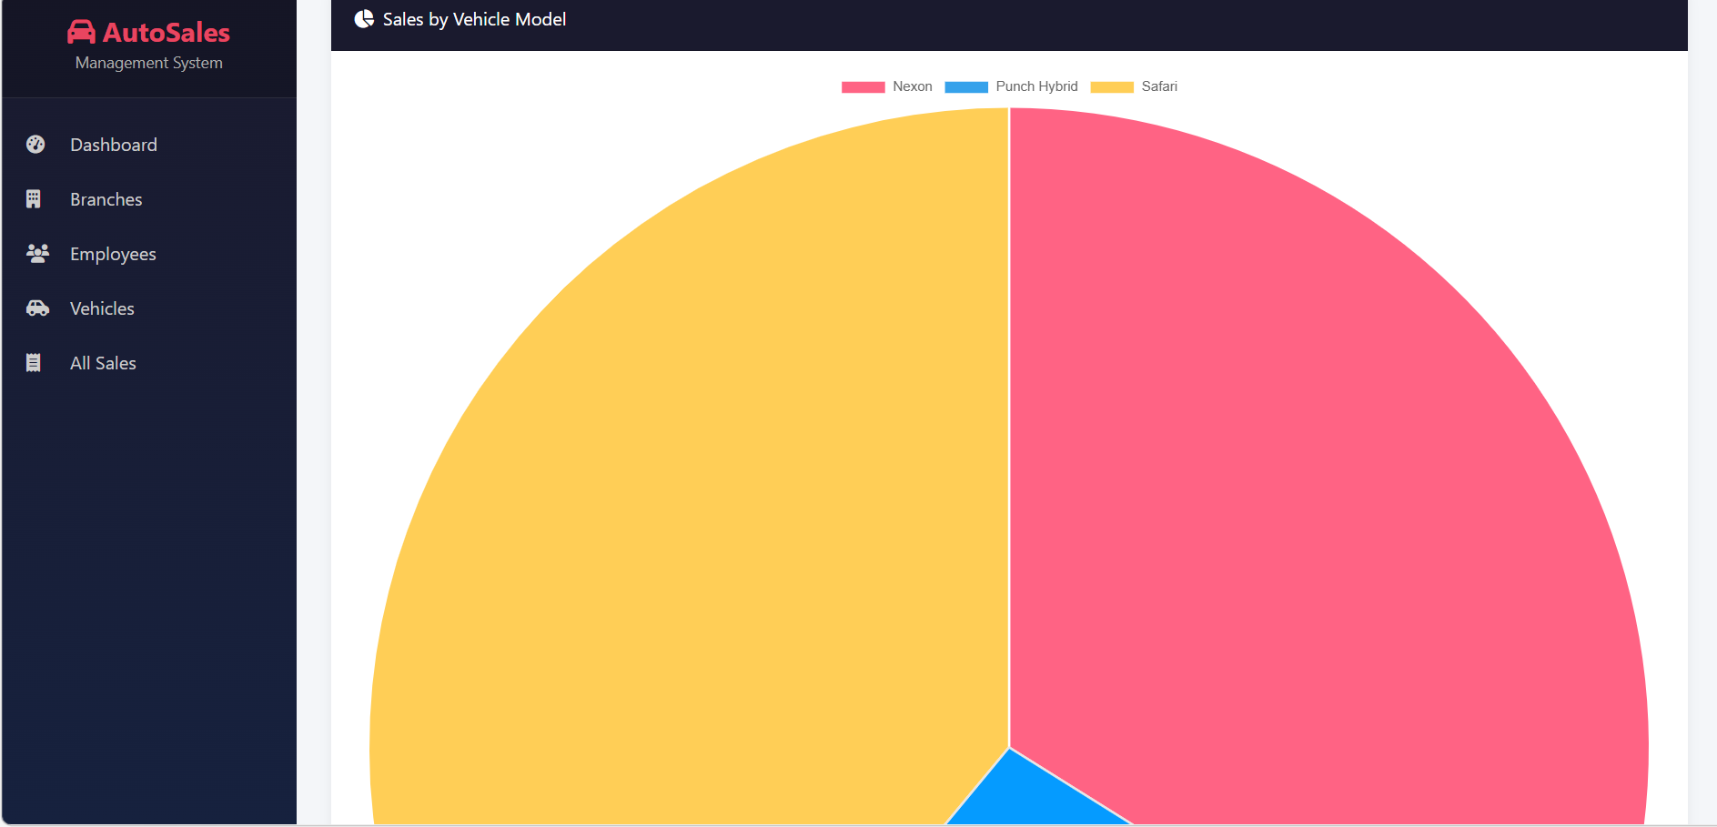
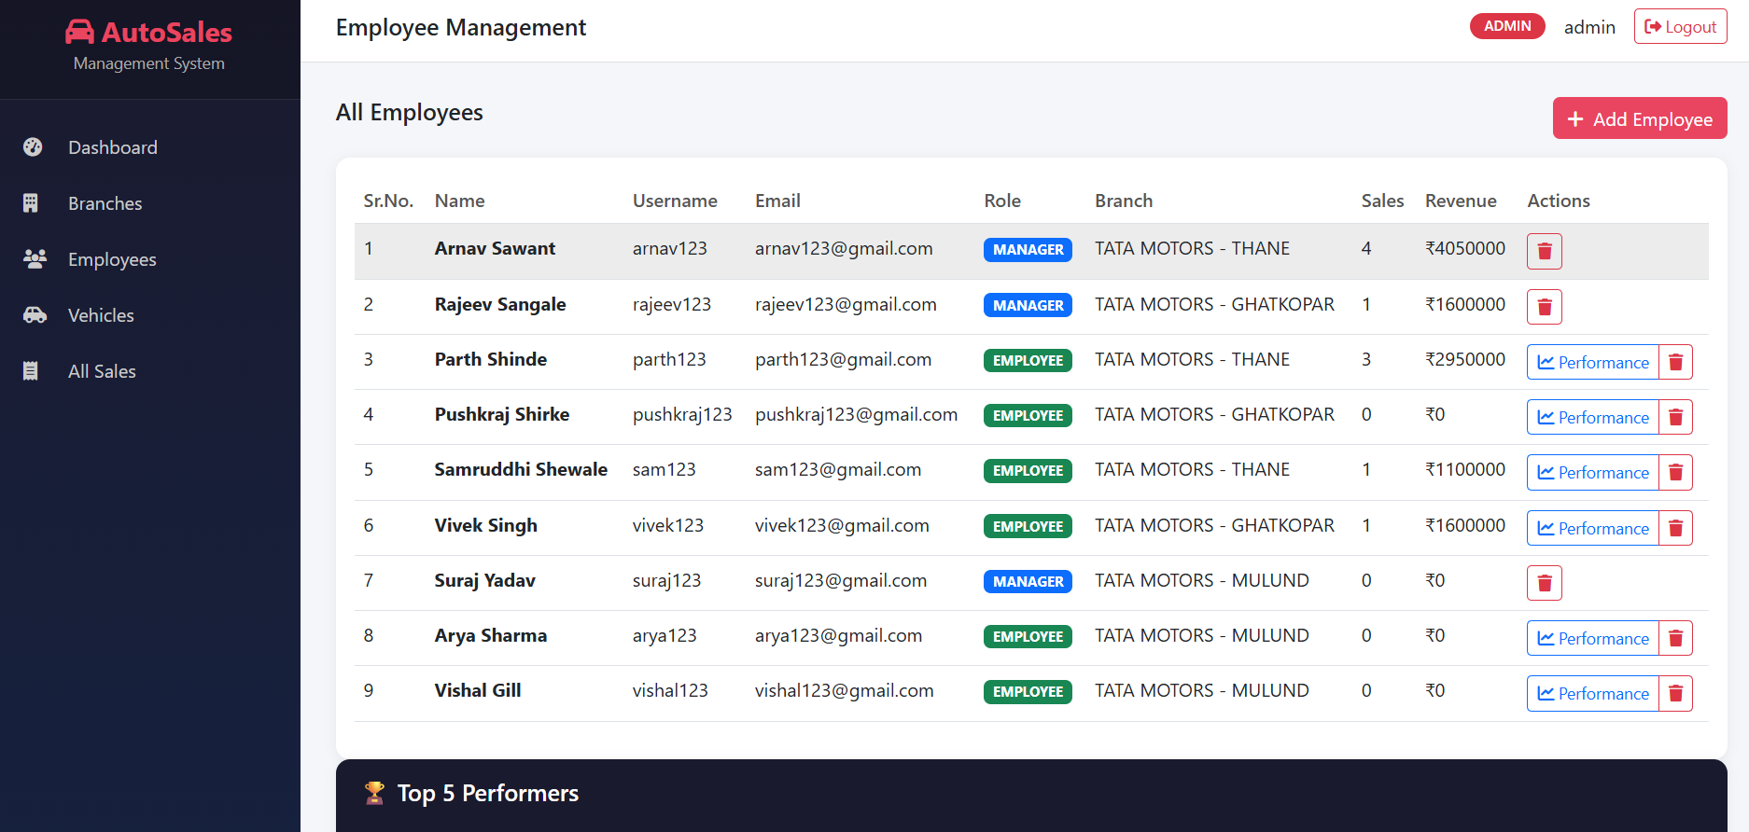
Implementation
Module: ADMIN

Slide 15
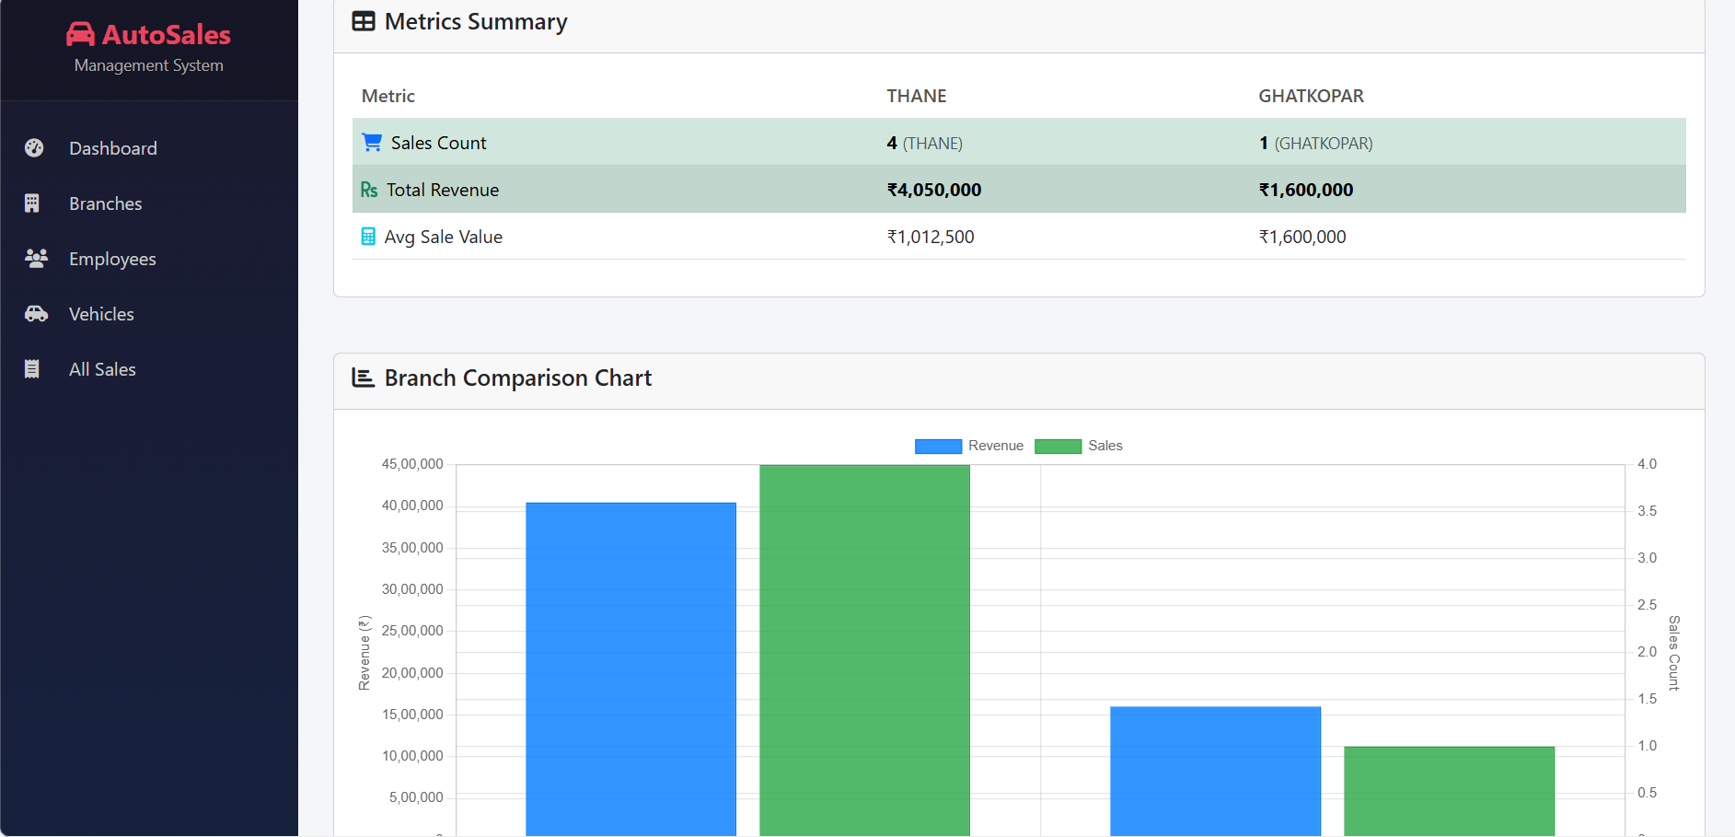
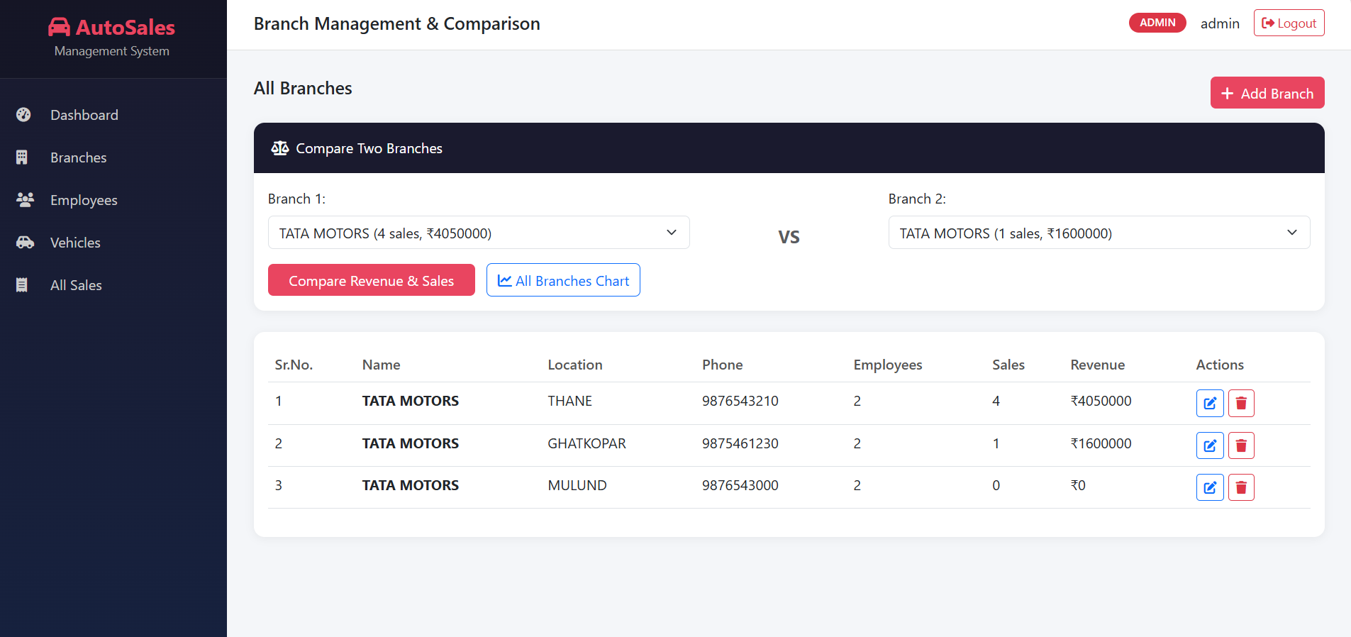
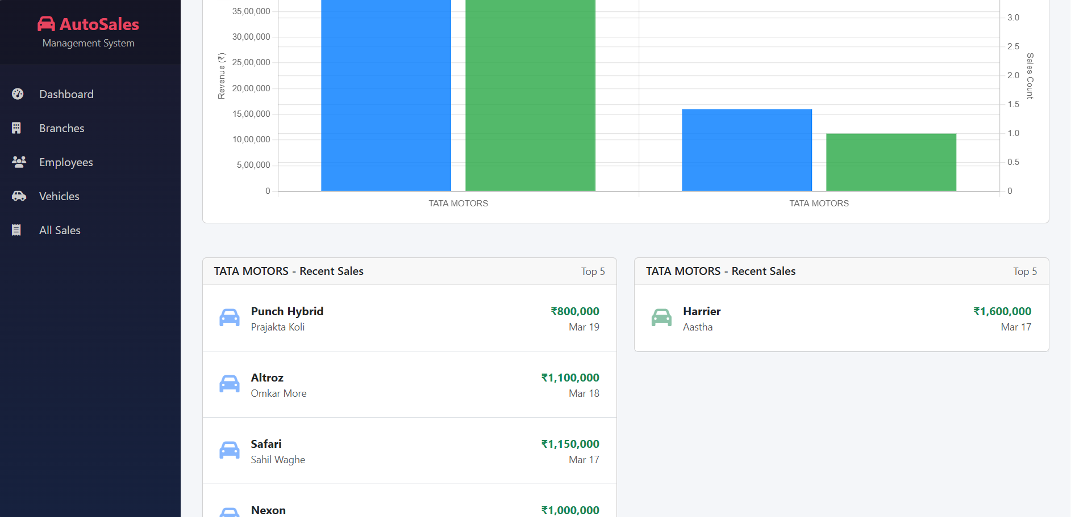
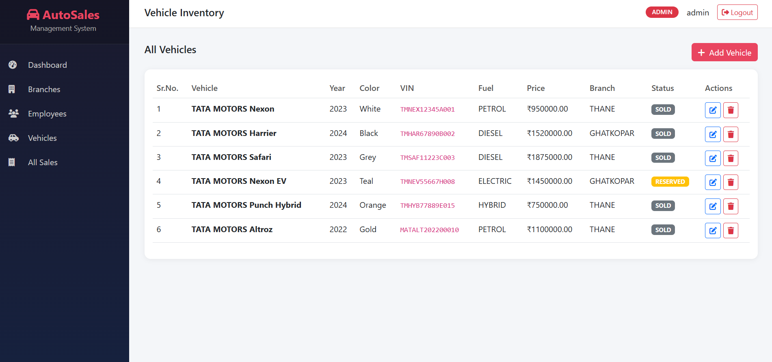
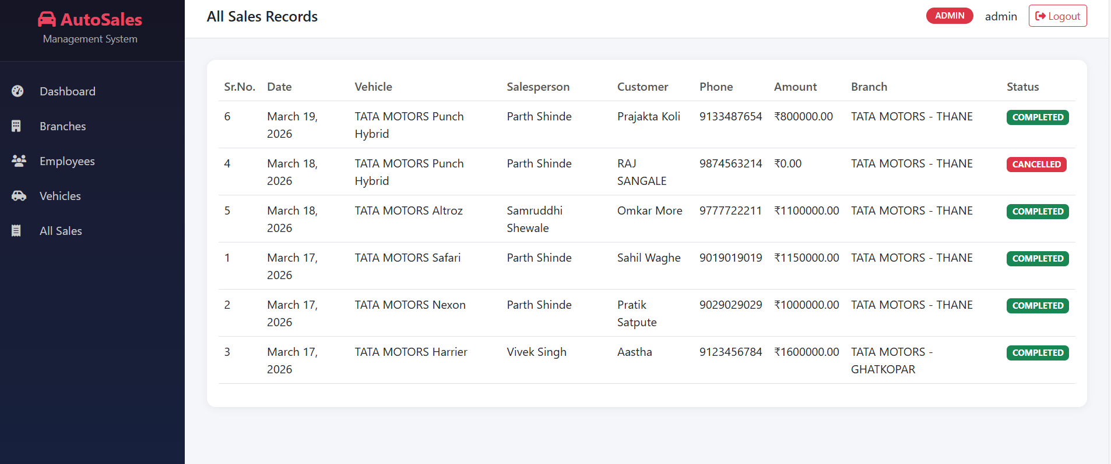
Implementation
Module: ADMIN

Slide 16
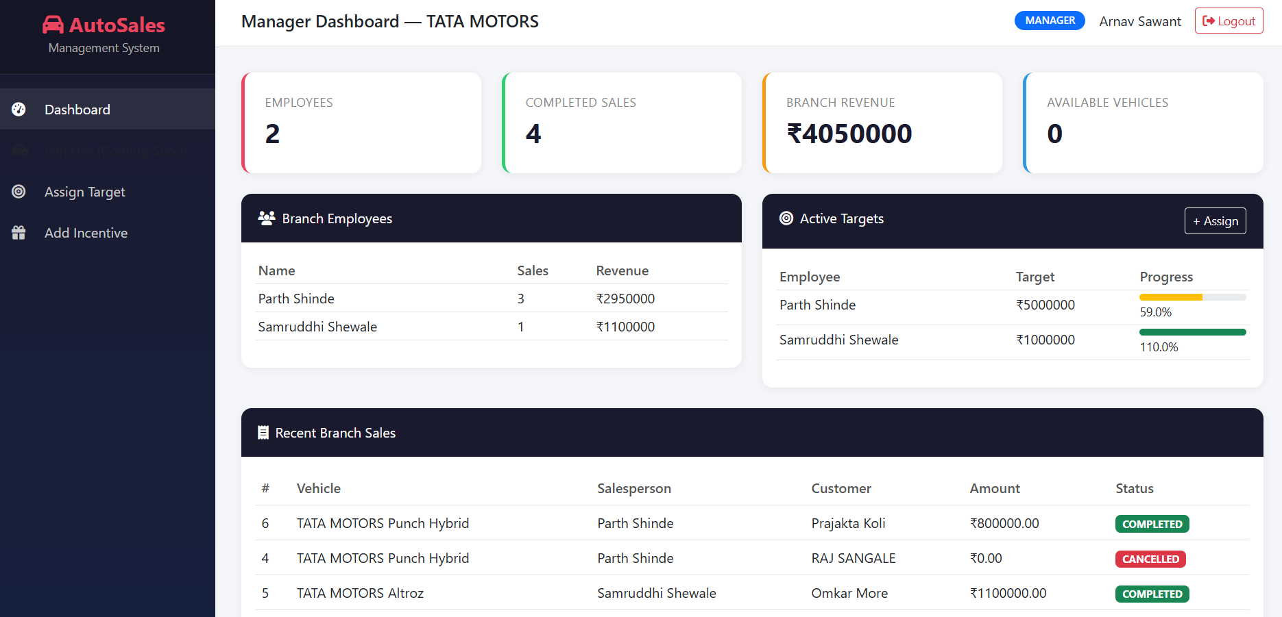
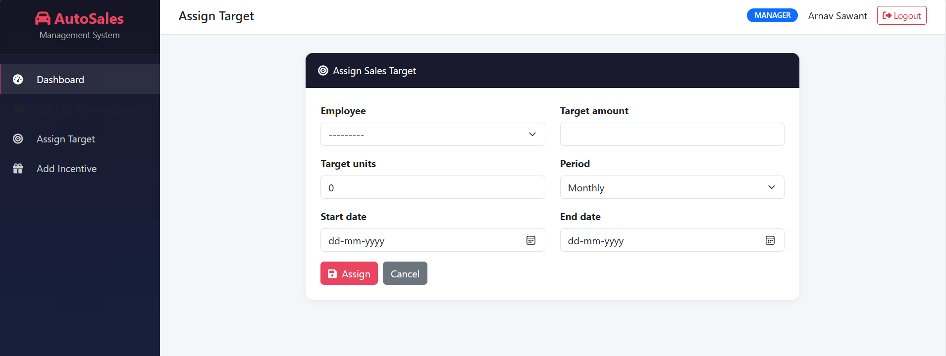
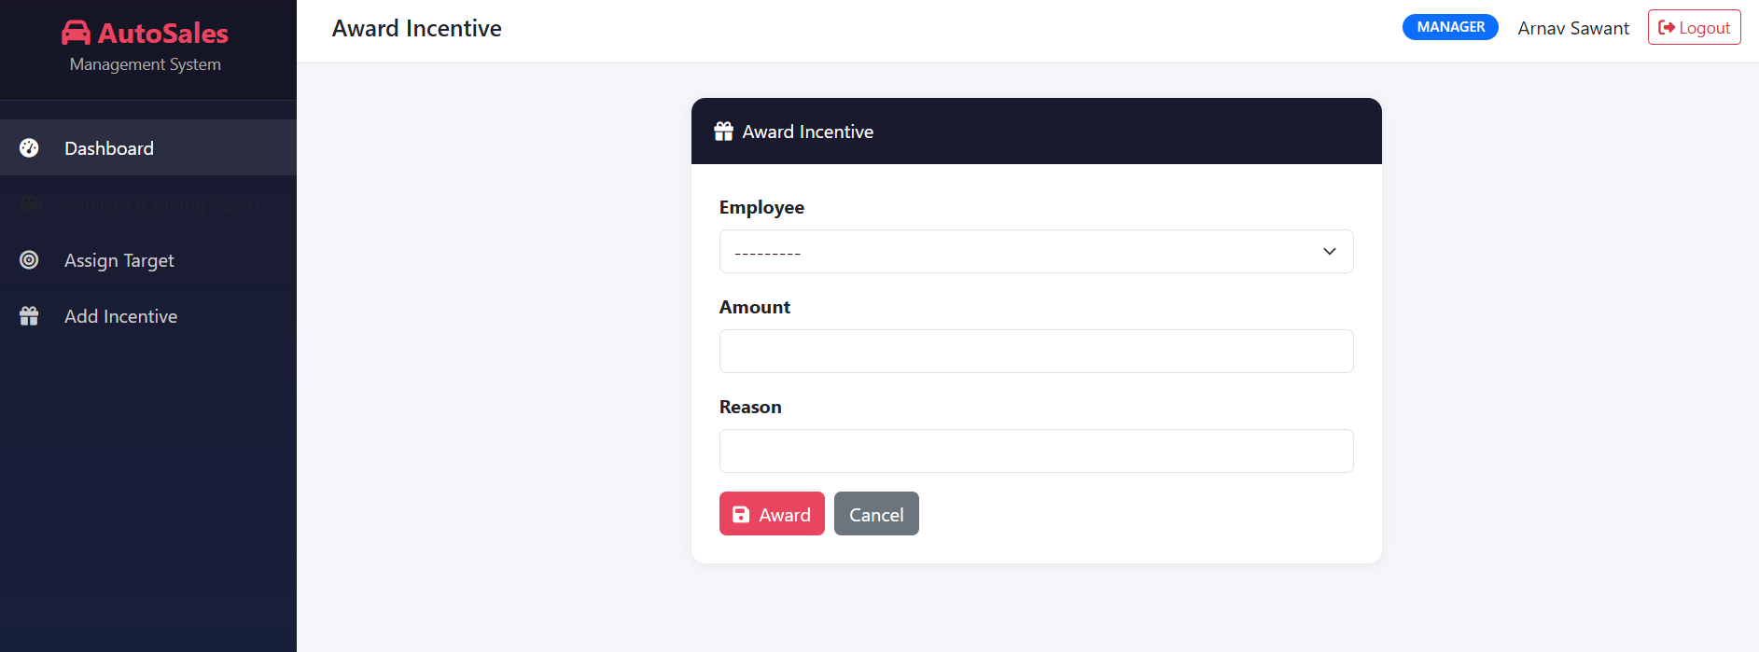
Implementation
Module: MANAGER

Slide 17
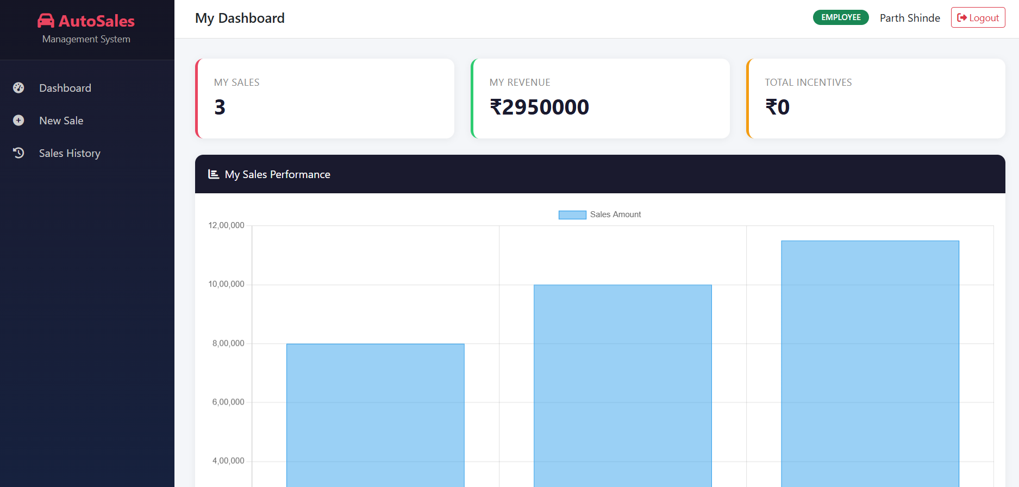
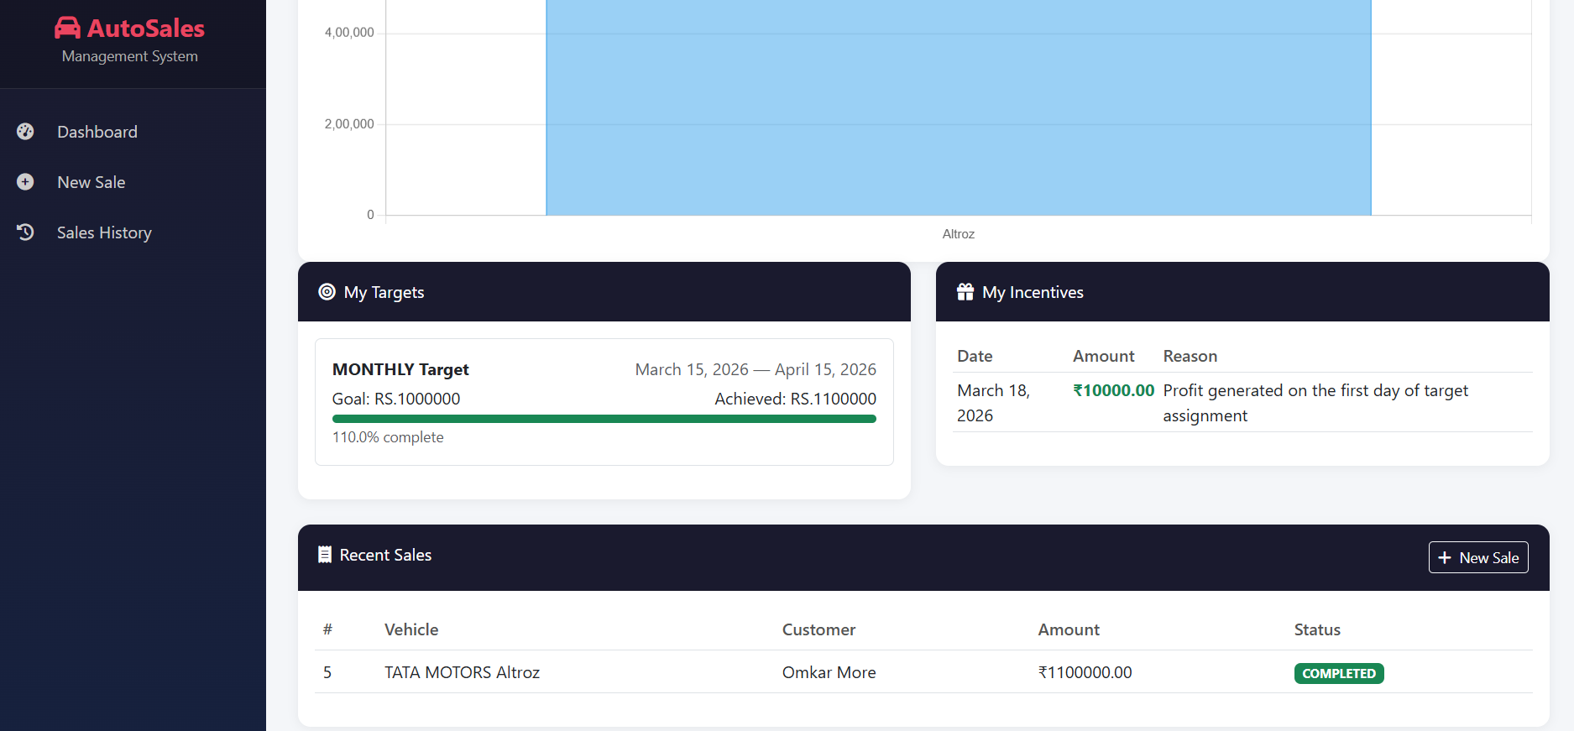
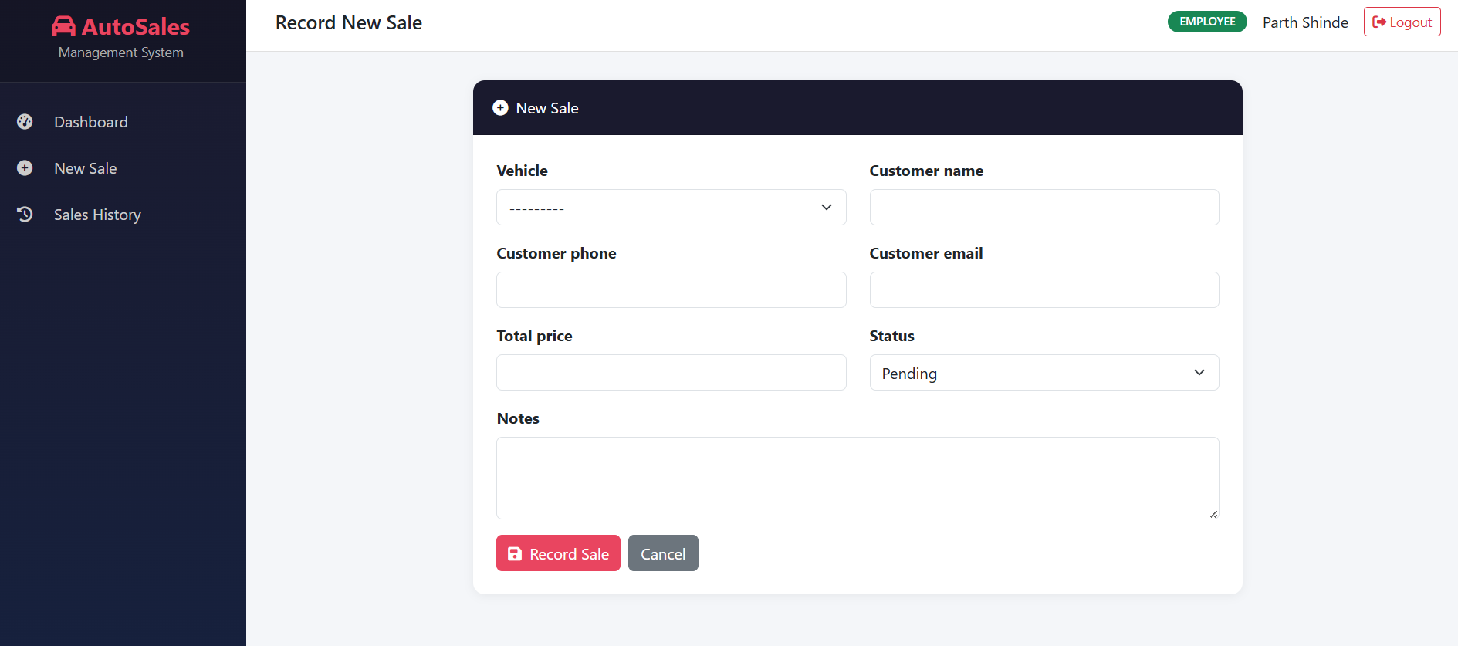
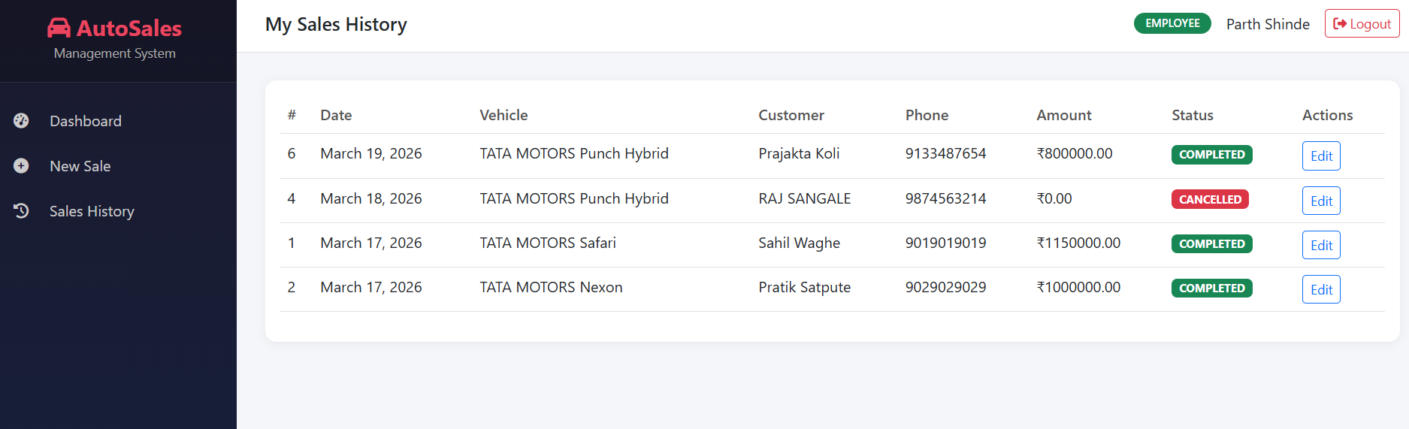
Implementation
Module: EMPLOYEE

Slide 18
Conclusion
Successfully digitized and centralized employee, sales, and branch operations.
Replaced manual record-keeping and fragmented systems with a secure, role-based web platform.
Implemented real-time dashboards and data visualization to improve performance transparency.
Enabled branch-to-branch comparison and performance trend analysis for better decision-making.
Ensured secure and structured system usage through Role-Based Access Control (RBAC).
Achieved core objectives: automation, centralized data management, improved efficiency, enhanced accuracy, and strengthened security.
Delivered a scalable, cost-effective solution suitable for multi-branch automobile organizations.
Future Work
Online Payment Integration
Smart Maintenance and Service Tracking

Slide 19
References
[1] S. Anu and P. Suresh Kumar, “HR Analytics in Automobile Industry,” Journal of Operations Management, vol. 12, no. 3, pp. 15–25, 2025.
[2] “Performance Analysis in Automotive Dealerships Using Regression Models,” ScienceDirect, 2024.
[3] “Predictive Analytics in Sales Performance,” Springer Journal of Data Analytics, vol. 8, pp. 101–115, 2022.
[4] R. Indupriya and K. Kalaiselvi, “Performance Appraisal Systems in Automobile Companies,” International Journal of Management Studies, vol. 6, no. 2, pp. 45–52, 2019.
[5] “Salesperson Performance Evaluation Using Analytics,” Applied Sciences, vol. 10, no. 11, pp. 4036, 2019.
[6] A. Sharma and T. Sharma, “HR Analytics and Performance Appraisal System: A Conceptual Framework,” International Journal of Human Resource Studies, vol. 7, no. 2, pp. 23–35, 2017.

Slide 20
Thank You...!!

